Slide 1
Unit-IV Disaster and Development
Disasters and development are closely linked. Disasters can both destroy development initiatives and create development opportunities. Development schemes can both increase and decrease vulnerability.

Slide 2
In the traditional approach to disasters, the attitude was that the disasters, especially natural ones, were an act of god and as such were beyond human control; accepting death and damage to property was part of the costs. With such an attitude, most development plans were designed without consideration for the effect disasters would have on community plans and vice versa. When a disaster did occur, the response was directed at meeting emergency needs and cleaning up

Slide 3
In the current approach, it has been realized that much more can and need to be done to reduce the severity of hazards and disasters. A growing knowledge on the relationships between disasters and development indicates four basic themes as follows:

Slide 4
Disasters set back development programming, destroying years of development initiatives.
Rebuilding after a disaster provides significant opportunities to initiate development programs.
Development programmes can increase an area’s susceptibility to disasters.
Development programmes can be designed to decrease the susceptibility to disasters and their negative consequences.

Slide 5
Thus, the policy makers cannot ignore the relationship between the disaster and development. Projects are thus being designed to include disaster recovery programmes and with long term development needs in mind. Disasters can significantly impede the effectiveness of development resource allocation.

Slide 6
The relationship between disaster and development-
Nations increase their capacities and decrease their vulnerabilities through development. Development planning is used by governments to draft plans to guide economic and social development. The concept of sustainable development is widely recognized by international agencies and by governments, although its definition is not universally agreed upon. Sustainable development is the outcome of comprehensive planning that incorporates considerations of disaster risk (reducing hazards and vulnerability) as well as strategies designed to protect the environment and to improve economic growth, levels of education, and living conditions of the entire population

Slide 7
Case study:
Disasters can provide unique windows of opportunity in development. In the wake of the 1986 earthquake in El Salvador, the health sector took advantage of the severe damage to the large Children's Hospital to restructure and decentralize services so that the nation would not be dependent on the services of one "megahospital."

Slide 8
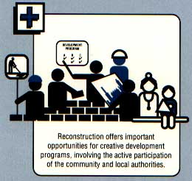

Slide 9
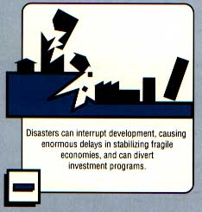

Slide 10
Development
Housing or infrastructure projects built in accordance with construction safety codes are less vulnerable because they have been designed to better withstand disaster impact. Research into construction of adobe dwellings in Peru, for example, aims to improve the performance of old and new dwellings in future seismic events.

Slide 11
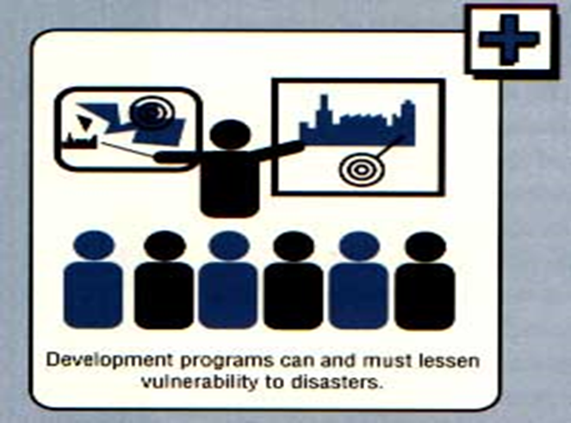

Slide 12
Activities related to development projects - such as quarrying for construction materials or indiscriminate clearing of forests for agricultural purposes - can degrade soil conditions, thereby increasing the risk of disasters. Other projects designed as income-generating opportunities can accelerate urban growth and force low income workers to seek housing in marginal, hazard prone areas.

Slide 13
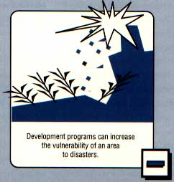

Slide 14
For a long time the cause and effect relationship between disasters and social and economic development was ignored. Ministries of Planning and Finance and other development planners did not concern themselves with disasters. At best, development planners hoped that disasters would not occur and, if they did, were most effectively handled by relief from donor countries and relief organizations. Development programs were not assessed in the context of disasters, neither from the effect of the disaster on the development program nor from the point of whether the development programs increased either the likelihood of a disaster or increased the potential damaging effects of a disaster.

Slide 15
Disasters were seen in the context of emergency response - not as a part of long term development programming. When a disaster did occur, the response was directed to emergency needs and cleaning up. Communities under disaster distress were seen as unlikely places to institute development. The post-disaster environment was seen as too turbulent to promote institutional changes aimed at promoting long term development.

Slide 16
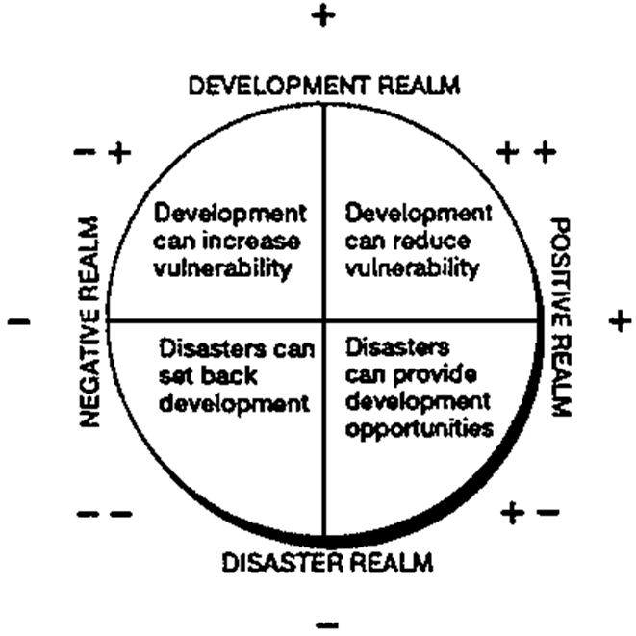

Slide 17
1. Disasters set back development programming destroying years of development initiatives.
- Infrastructure improvement e.g. transport and utility systems are destroyed by a flood.

Slide 18
flood.
2. Rebuilding after a disaster provides significant opportunities to initiate development programs.
- A self-help housing program to rebuild housing destroyed by an earthquake teaches new skills, strengthens community pride and leadership and retains development dollars that otherwise would be exported to large construction companies.

Slide 19
3. Development programs can increase an area’s susceptibility to disasters.
- A major increase in livestock development leads to overgrazing, which contributes to desertification and increases vulnerability to famine.

Slide 20
4. Development programs can be designed to decrease the susceptibility to disasters and their negative consequences.
- Housing projects constructed under building codes designed to withstand high winds result in less destruction during the next tropical storm.

Slide 21
Impact of Development Projects
Dams are massive barriers built across rivers and streams to confine and utilize the flow of water for human purposes such as irrigation and generation of hydroelectricity. This confinement of water creates lakes or reservoirs.

Slide 26
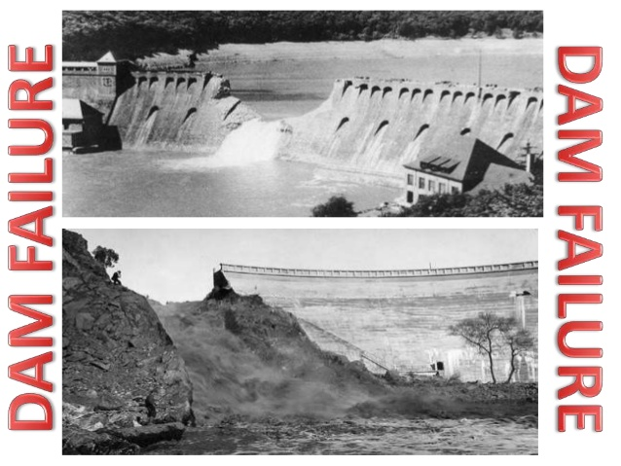

Slide 28
Embankment
An embankment dam is a large artificial dam.
It is typically created by the placement and compaction of soil, sand, clay, or rock.

Slide 29
IMPACT OF BREACHING
interferes with the geomorphological processes of the
River (overtopping, meandering nature of the river, alignment of embankment, poor maintenance of the embankment and other anthropogenic activities)
quality of construction of such embankments is never uniformly good
embankments themselves deteriorate with time due to erosion by rainfall

Slide 30
interference by humans (e.g., cutting embankments to allow for the passage of irrigation water in the dry season), burrowing of animals, and road or other traffic along and across the structure, etc.
huge flood water rushing through the agricultural field and settlements and also has given rise to the sand incursion over that fertile agricultural fields making them unproductive.
the affected people compelled to migrate from one occupation to other.

Slide 31
Land use
Major land–use changes have occurred in the United States during the past 25 years.
total area of cropland, pastureland decreased by 76 million acres in 48 states from 1982 to 2003, while total area of developed land increased by 36 million acres or 48%.
In Indonesia, about 500 sq km of forest area are cleared each year, replaced with oil palm plantations.
In many countries, including India, cities are expanding well beyond their formal limits

Slide 32
urbanization
Transforming land use from agriculture and forests into industry, residential, commercial buildings, other infrastructure and horticulture.
spaces of perii-urban areas (outside city limits) become sites from which
groundwater is pumped and transported to the city
new industrial zones are developed
urban waste is dumped
vegetables and other high-value crops are grown for nearby urban centers.

Slide 33
Land use change is a process by which human activities transform the natural landscape.
It affects soil properties.
Depending on the intensity and type of use, soil may be modified in its
physical properties (structure, consistency, and density)
chemical (e.g., cation exchange capacity, pH, soil salinity etc.)

Slide 34
Effects
effects on climate change.
changes in soil properties.
disruption of soil functions (construction of roads …)
converting agricultural land for housing or industry, filling up ponds and building housing complexes on lake beds, etc. impact ecosystem services

Slide 35
Remedies
protecting water bodies,
conserving groundwater,
reducing our ecological footprint and
living in more compact communities are good ways to address both climate change mitigation and adaptation, reducing greenhouse gases.
requires more research to provide guidance to policymakers.

Slide 36
FACTORS AFFECTING VULNERABILITY
Human Factors:
different people, even within the same region, have different vulnerability to natural hazards.

Slide 37
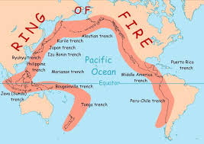

Slide 38
Ring of Fire is a major area in the basin of the Pacific Ocean where many earthquakes and volcanic eruptions occur.
large 40,000 km horseshoe shape.
About 90% of the world's earthquakes and 81% of the world's largest earthquakes occur along the Ring of Fire.

Slide 39
Wealth :
poor - less able to afford housing and other infrastructure that can withstand extreme events.
less able to purchase resources needed for disaster response
less likely to have insurance policies that can contribute.
less likely to have access to medical care.

Slide 40
Exceptions: some coastal areas contain expensive beachside real estate populated mainly by the rich, leaving the rich more vulnerable to tsunamis, storm surges, and other coastal hazards.
rich tend to lose more money from disasters, simply because they have more valuable property at stake.
Eg. Hurricane Katrina (wealthier area, fewer deaths, higher monetary damage); Cyclone Nargis (poorer area, more deaths, less monetary damage).

Slide 41
Education :
With education, we can learn how to avoid or reduce many impacts.
When populations are literate, then written messages can be used to spread word about hazards in general or about specific disasters.
Even without literacy, it is possible to educate a population about hazards in order to help it reduce its vulnerability.
When populations include professionals trained in hazards, then these people can help the populations with their hazards preparations and responses.

Slide 42
Governance :
Governments can advance policies that reduce vulnerability.
They can establish agencies tasked with reducing vulnerability, such as NDMA. (National Disaster Management Authority)

Slide 43
On 23 December 2005, the Government of India enacted the Disaster Management Act, which envisaged the creation of the National Disaster Management Authority (NDMA), headed by the Prime Minister, and State Disaster Management Authorities (SDMAs) headed by respective Chief Ministers, to spearhead and implement a holistic and integrated approach to Disaster Management in India.

Slide 44
NDMA Vision "To build a safer and disaster resilient India by a holistic, pro-active, technology driven and sustainable development strategy that involves all stakeholders and fosters a culture of prevention, preparedness and mitigation."

Slide 45
They can support education and awareness efforts, as well as economic development to reduce poverty.
Finally, they can foster social networks and empower individuals and communities to help themselves to prepare for and respond to hazards.

Slide 46
without government
communities can informally engage in many of these governance activities.
Often the most vulnerable people are those who are politically marginalized, because these people have less access to key resources and opportunities.
Eg. Myanmar government during Cyclone Nargis. This government is isolated from the international community and, thus, was not welcoming to international assistance in the aftermath of the cyclone.
Haiti after its 2010 earthquake. Haiti, like Myanmar, is a poor country, but it has positive and close relationships with the international community and thus readily welcomed international assistance in the aftermath of the earthquake. This assistance saved many lives and is helping Haiti rebuild.

Slide 47
Technology :
Technology can improve our ability to forecast extreme events, withstand the impacts of the events, and recover afterwards.
Technology is closely tied to wealth, education, and governance.
Wealthier, more educated society's are more likely to have more advanced technology.
A society's governance systems play a large role in how - and how effectively - the available technology is used in a disaster situation.

Slide 48
Age:
Children and the elderly tend to be more vulnerable. They have less physical strength to survive disasters and are often more susceptible to certain diseases.
The elderly often also have declining vision and hearing.
Children, especially young children, have less education.
Finally, both children and the elderly have fewer financial resources and are frequently dependent on others for survival.
In order for them to survive a disaster, it is necessary for both them and their caretakers to stay alive and stay together.
Eg. 2003 European heat wave. About 40,000 people died in one of the hottest summers ever in Europe. Many of the deaths were elderly people who were still capable of taking care of themselves. These people were not able to adapt to the extreme heat and had no one helping them out.

Slide 49
Gender :
Women are often more vulnerable to natural hazards than men.
because women are more likely to be poor, less educated, and politically marginalized.
Women often face additional burdens as caretakers of families.
When disaster strikes, women are often the ones tasked with protecting children and the elderly.
This leaves them less mobile and more likely to experience harm themselves.

