Slide 1
Unit-3
Business Performance Measurement (BPM)
By: Prof. K.V. PAVAN KUMAR,
Methodist College of Engg & Tech.,
Abids, Hyd.

Slide 2
1. Business PERFORMANCE MEASUREMENT (bpm) - Definition:
Business performance measurement (BPM) refers to the management and analytical process employed by the management of an organization to assess the performance of the organization to achieve the goals pre- defined by the management of the organization.

Slide 3
BPM may be defined as “different business tools, techniques, methodologies and metrics employed by an organization to measure, monitor and manage the performance of the business enterprise”.

Slide 4

Performance measures let us know:
1
how well we are doing
2
if we are meeting our goals
3
if our customers are satisfied
4
if our processes are in statistical control
if and where improvements are necessary.
5

Slide 5
Essential Elements of Performance Measures
(by Ray F. Boedecker)
Objectives
Typical measurement
Criteria
Characteristics

Slide 6
1. Objectives
- Performance measurements as used to achieve one or more of the following six objectives:
Establish baseline measures and reveal trends
Determine which processes need to be improved
Indicate process gains and losses
Compare goals with actual performance
provide information for individual and team evaluation
Manage by fact rather than gut felling

Slide 7
2. Typical Measurement
- What should be measured is frequently asked by managers and teams.
Human resources
Customers
Production
Research development
Suppliers
Marketing/Sales
Administration

Slide 8
3. Criteria
- All business organizations have some measurements in place that can be adopted for TQM. In order to evaluate the existing measures or add new ones, there are seven criteria to be followed:
Simple
Few in number

Slide 9
Developed by users
Relevance to customer
Improvement
Cost
Visible

Slide 10
4. Characteristics
- One of the seven basic characteristics is used to measure the performance of a particular process or function.
Quantity – most common measures; refers to how many units a production or business produces
Cost – amount of resources required to produce a given output
Time

Slide 11
Accuracy – number of non-conformances in the output
Function
Aesthetics – how the product looks, feels, sounds, tastes, or smells and is quite subjective
Service – service activity

Slide 12



Slide 13
Why do we need to measure?
Control:
Measurements help to reduce variation
Self-Assessment:
Measurements can be used to assess how well a process is doing, including improvements that have been made
Continuous Improvement:
Measurements can be used to identify defect sources, process trends, and defect prevention, and to determine process efficiency and effectiveness, as well as opportunities for improvement
Management Assessment:
Without measurements there is no way to be certain we are meeting value-added objectives or that we are being effective and efficient

Slide 14
2. BPM VS BI:
Key differences of BPM and BI:
1) Meaning:
A)BPM: BPM refers to the different tools, methods and metrics employed by an organization to measure, monitor and management business Performance.
B) BI: BI refers to the art and science of analyzing any data or information, with a specific business Objective.

Slide 15
Key differences of BPM and BI:
2) SCOPE:
BPM: The Scope of BPM is wider.
BI: The Scope of BI is comparatively narrower.

Slide 16
Key differences of BPM and BI:
3) TOOLS USED:
BPM: BPM employs multiple tools, methods and metrics, which includes all the BI tools as well.
BI: BI employs a wide variety of tools and techniques such as OLP adhoc querying, dashboards, scorecards etc.

Slide 17
Key differences of BPM and BI:
4) PROCESS INVOLVED:
BPM: BPM involves multiple processes including BI+, Planning, cycle of plan, monitoring and analyzing of Business Performance.
BI: BI processes are limited only upto analyzing of Business Data.

Slide 18
Key differences of BPM and BI:
5) NATURE:
BPM: BPM is highly flexible in nature and is actively integrated with the ongoing organizational projects.
BI: BI is static in nature. Its primary focus is upon measuring the performance of already completed business projects.

Slide 19
3. Summary of BPM Process :
Business performance measurement (BPM) refers to the management and analytical process employed by the management of an organization to assess the performance of the organization to achieve the goals pre- defined by the management of the organization.

Slide 20
Business performance management is also known as corporate performance management or enterprise performance management.

Slide 21
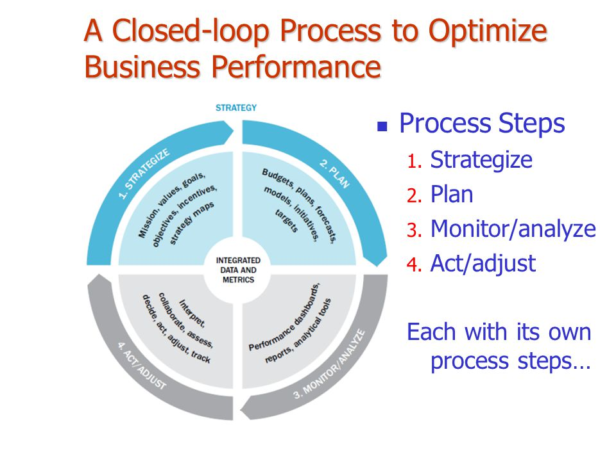
BPM PROCESS

Slide 22
Summary of Business Performance Management Process:
A) BMP is a set of integrated, closed-loop management and analytic processes, supported by technology, that address financial as well as operational activities.
B) BPM is an enabler for businesses in defining strategic goals, and then measuring and managing performance against those goals.

Slide 23
Key differences of BPM and BI:
C) Core BPM processes include:-
Financial and operational planning, consolidation and reporting, modeling, analysis and monitoring of key performance indicators (KPIs) linked to organizational strategy.

Slide 24
4. Performance Measurement:
Performance measurement is the process of collecting, analyzing and/or reporting information regarding the performance of an individual, group, organization, system or component.

Slide 25
Performance refers to output results and their outcomes obtained from processes, products, and services that permit evaluation and comparison relative to goals, standards, past results, and other organizations. Performance can be expressed in non-financial and financial terms.

Slide 26
Measurement refers to numerical information that quantifies input, output, and performance dimensions of processes, products, services, and the overall organization (outcomes).
Performance measures might be simple (derived from one measurement) or composite.

Slide 27
There are a number of challenges that are faced when designing an effective Performance Measurement System, these include the following:
How to measure non-financial performance
What measures to choose and why

Slide 28
How to use them - what to do with the results
Who should be responsible for using the results
How and to whom, to communicate the results
The resources needed to consider the above and design and deploy the measurement system

Slide 29
Performance Measurements for the new era
In the global, technology-driven, decentralized environment, measuring
Financial performance, while important, is not adequate.
Even if less than precise, other measures of performance are required.
These measures should be capable of measuring multiple attributes of an organization.

Slide 30
We need a balanced set of
Performance Measures –
We need both lead and lag indicators

Slide 31
Lead indicators as value drivers
Many non-financial indicators can serve as lead indicators in certain settings.
Common examples are:
  Market share, new product introductions, new product development lead times, product quality, customer satisfaction, employee morale, personnel development, inventory turnover, bad debt ratio, or safety

Slide 32
Lag Indicators
In contrast to lead indicators, lag indicators are measures that point to earlier plans and their execution.
Financial performances are lag indicators.
Many times, financial performances are too late to affect future products and services.
Therefore, we need multiple measures that include both financial and non-financial measures.

Slide 33
Comprehensive Performance Measures must address
Financial performance
Customer satisfaction
Internal business process developments and
Allow an organization to learn and grow.

Slide 34
Financial Performance can be measured by
ROI, ROA, ROE, EPS etc. These measure are essential to summarize the economic consequences of any company’s strategy.

Slide 35
Customer-related measures
Managers must identify the customer and market segments in which the business desires to compete.
Develop measures to track the business unit’s ability to create satisfied and loyal customers.

Slide 36
Customer-based measures
Customer Satisfaction
Customer Retention
Customer Loyalty
Product and Service Attributes
Image and Reputation

Slide 37
Internal Business Process (IBP) Measures:
Identify the critical internal processes for which the organization must excel in implementing its strategy.
IBP dimension enable the business unit to:
  Deliver the value propositions that will attract and retain customers in targeted market segments, and
  Satisfy shareholder expectations regarding financial returns.

Slide 38
Internal Business Process Measures
Innovation processes
Operation Processes
Quality Measures
Cycle Time Measures
Cost Measures

Slide 39
Learning and Growth measures
Learning and growth identifies the infrastructure an organization must build to create long-term growth and improvement.
Growth comes from: people, systems and organizational procedures.

Slide 40
A performance concept that combines everything that we discusses so far is:
Six Sigma

Slide 41
The Six Sigma
Is “a business process that enables companies to increase profits dramatically by streamlining operations, improving quality, and eliminating defects or mistakes in everything a company does. “
The objective is change the process so that defects are never produced in the first place.

Slide 42
The objectives of Six Sigma
To ‘Satisfy the Customer’ by changing internal performance and processes.
To enable better performance by better design
To Improve the ‘Quality’ of Supplies and other ‘Operational Processes’.
Manage the costs

Slide 43
Six Sigma points out
You don't know what you don't know -- You can't do what you don't know..
You don't know until you measure..
You don't measure what you don't value..
You don't value what you don't measure..

Slide 44
5. BPM Methodologies:
Methodology Element: Specific Procedures or techniques
1) Management:
List of all core and support processes; list and definitions of leadership and team roles and responsibilities .
2) Process improvement with phases
Definition of phases; examples of required and optional work products in charter, discovery, analysis and redesign phases

Slide 45
3) Measurement
Data elements for before and after; analytical data elements; customer data, competitive data, and ongoing monitoring data. Decisions from data.
4) Learning
Skills needed for BPM techniques; delivery of training and real time learning; learning for BPM leadership, project and team roles

Slide 46
5)Alignment with Organizational Priorities:
Techniques to prioritize processes such as strategic plan, Enterprise architecture, 3 x 3 box performance criteria etc.
6) Continuous Improvement:
Roles, monitoring frequency, monitoring methods and signals

Slide 47
7)Technology:
Standard technologies used across the enterprise. Where are custom technologies used and why?
8)BPM Common Practices
Agreed internal common practices, such as roles, analysis techniques, group, assessment

Slide 48
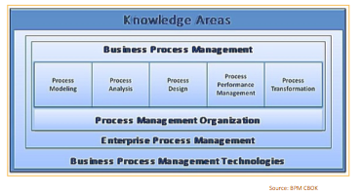

Slide 49
6. BPM Architecture and Applications:
BPM ARCHITECTURE:
BPM architecture is intended to ensure that a company automates its business processes. It can be said that BPM architecture is a general definition of an entire system of processes. The intended use of good BPM architecture is to improve processes and hence optimize results.

Slide 50
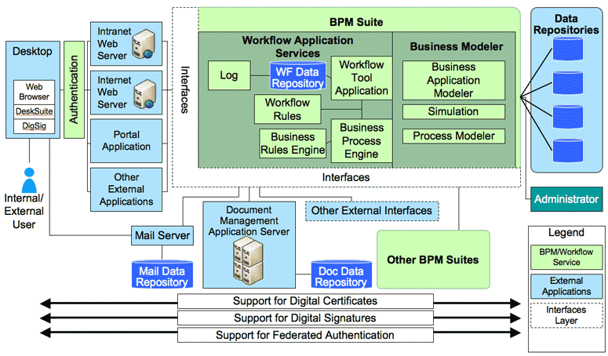

Slide 51
BMP Applications:
Business process management (BPM) is a systematic approach to making an organization's workflow more effective, more efficient and more capable of adapting to an ever-changing environment.
A business process is an activity or set of activities that will accomplish a specific organizational goal.

Slide 52
7. Performance Dash boards:
A dashboard report provides visual feedback on the performance of a business, department, project, or campaign.
However, an effective dashboard provides more than just a summary of relevant data - if insight and analysis are also included, a dashboard can be a great tool for quickly reviewing key metrics as well as actions that need to be taken.

Slide 53
The people collecting and analyzing data may not be the final decision-makers, so including analysis and recommended actions in the dashboard can create a more useful report. Additionally, this can help close any communication gap between analysts and executives who need thorough information in order to make strategic decisions.
Ultimately, a dashboard has the potential to save time, provide clear communication, and drive business goals in the right direction.

Slide 54
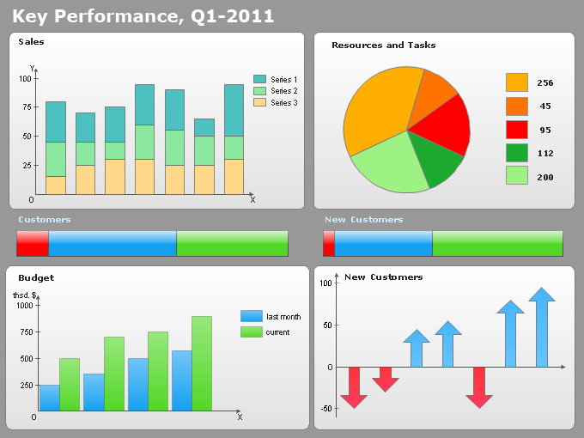
Performance dashboards

Slide 55
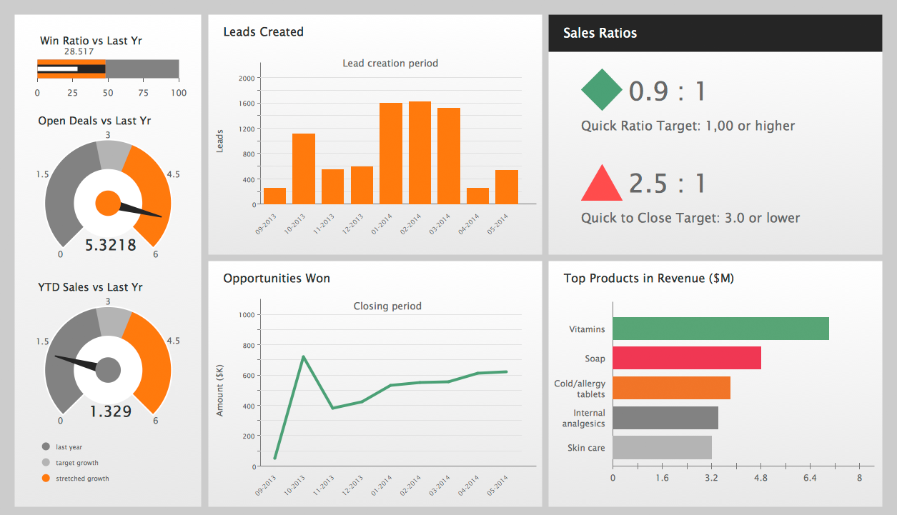
Performance dashboards

Slide 56
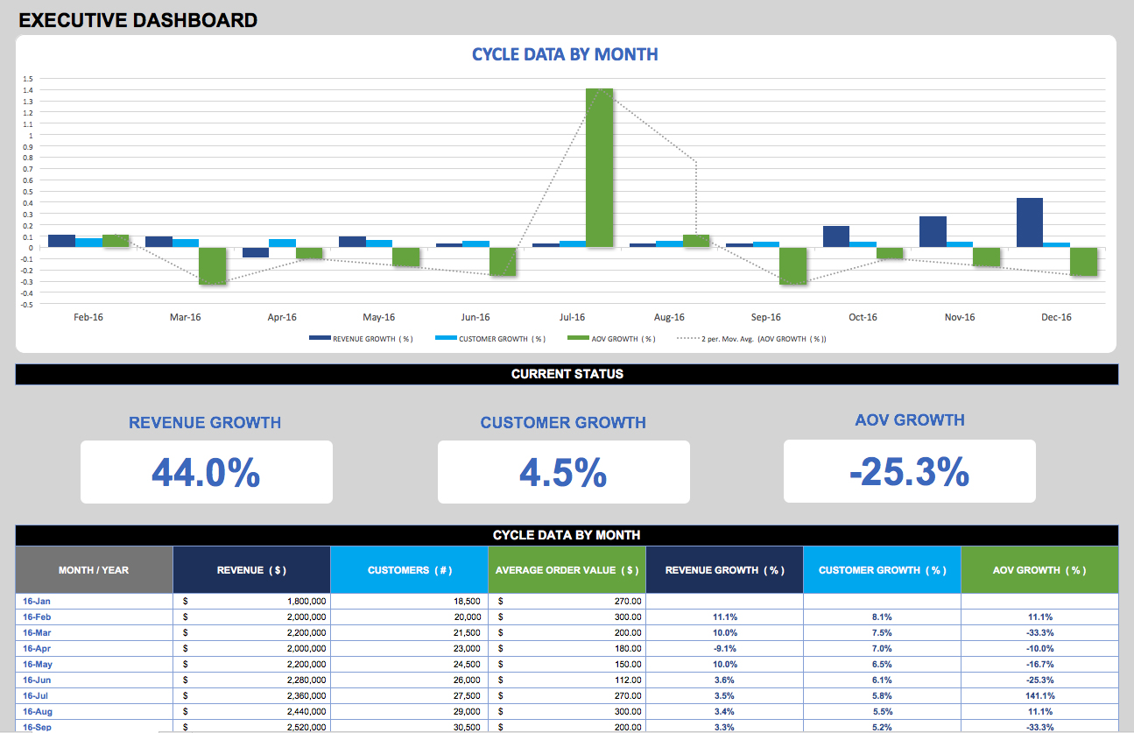
Performance dashboards

Slide 57
END OF UNIT-3

